Slide 1
Mixed Circuit Analysis

Slide 2
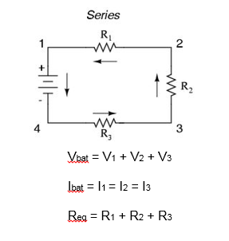
Series Circuit – Kirchhoff's Rules

Slide 3
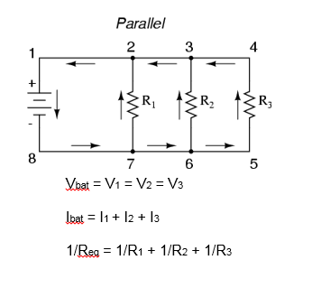
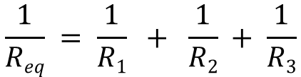
Parallel Circuit – Kirchhoff's Rules
$$\frac{1}{Req} = \frac{1}{R1} + \frac{1}{R2} + \frac{1}{R3}$$

Slide 4
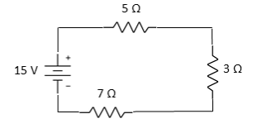
Series Circuit – Equivalent Resistance
Find the Equivalent Resistance of the following circuit (use: R_{eq} = R₁ + R₂ + R₃)

Slide 5
Series Circuit – Equivalent Resistance
Use the Equivalent Resistance to find the following:
Battery Current (use: I = V/R)
Voltage drop across each resistor (use: V = IR)

Slide 6
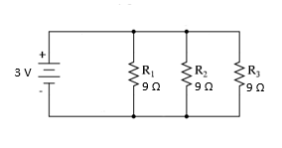
Parallel Circuit – Equivalent Resistance
Find the Equivalent Resistance of the following circuit (use: 1/R_{eq} = 1/R₁ + 1/R₂ + 1/R₃)

Slide 7
Parallel Circuit – Equivalent Resistance
Use the Equivalent Resistance to find the following:
Battery Current (use: I = V/R)
Voltage drop across each resistor (use: V = IR)

Slide 8
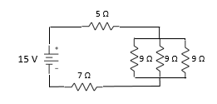
Mixed Circuits – Equivalent Resistance
Solve the following Mixed Circuit
Solve Means: Find V, I, and R for each resistor

Slide 9
Mixed Circuits – Equivalent Resistance
Hint: How is the mixed circuit Equivalent to the series circuit?

Slide 10
Mixed Circuits – Equivalent Resistance
2nd Hint: How is the mixed circuit Equivalent to the series circuit?

Slide 11
Mixed Circuits – Equivalent Resistance
Solve the following Mixed Circuit
Solve Means: Find V, I, and R for each resistor

Slide 13
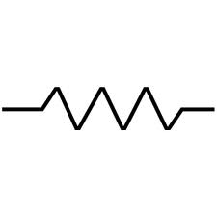
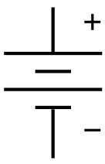
Find The Battery Current - 1
5 Ω
45 V
4 Ω
Hint
6 Ω
45 V
15 Ω

Slide 14
Find The Battery Current - 2
5 Ω
45 V
12 Ω
12 Ω
12 Ω
12 Ω
12 Ω
Hint
5 Ω
45 V
4 Ω
6 Ω

Slide 15
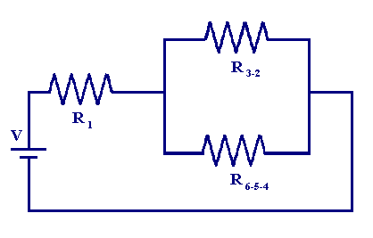
Sample Circuit 1
Strategy:
Identify An Area to Simplify
Simplify the Area
Draw the Equivalent Circuit
Solve the Equivalent Circuit
R2
R1
R3
V = 12 V
R1 = 6 Ω
R2 = 4 Ω
R3 = 4 Ω
Find The Current In Each Part Of The Circuit

Slide 16
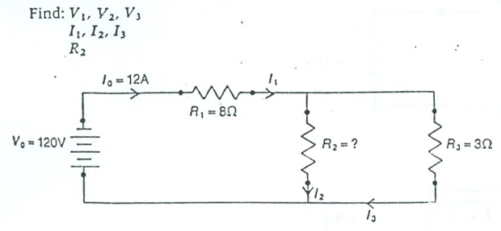
Sample Circuit 2
Strategy:
Identify An Area to Simplify
Simplify the Area
Draw the Equivalent Circuit
Solve the Equivalent Circuit

Slide 17
Kirchhoff's Laws
Series Circuits | Parallel Circuits
R_{T}= R1 + R2 + R3 + ... | 1/R_{T} = 1/R1 + 1/R2 + 1/R3 + ...
I_{T} = I1 = I2 = I3 = ... | I_{T} = I1 + I2 + I3 + ...
V_{T} = V1 + V2 + V3 + ... | V_{T} = V1 = V2 = V3 = ...

Slide 18
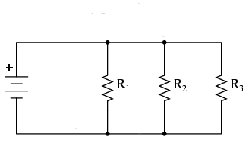
5 Ω
45 V
15 Ω
45 V
4 Ω
6 Ω
5 Ω
45 V
12 Ω
12 Ω
12 Ω
12 Ω
3 V
12 Ω
9 Ω
9 Ω
9 Ω

